Slide 1
Progress update
Timothy Allen summer RA

Slide 2
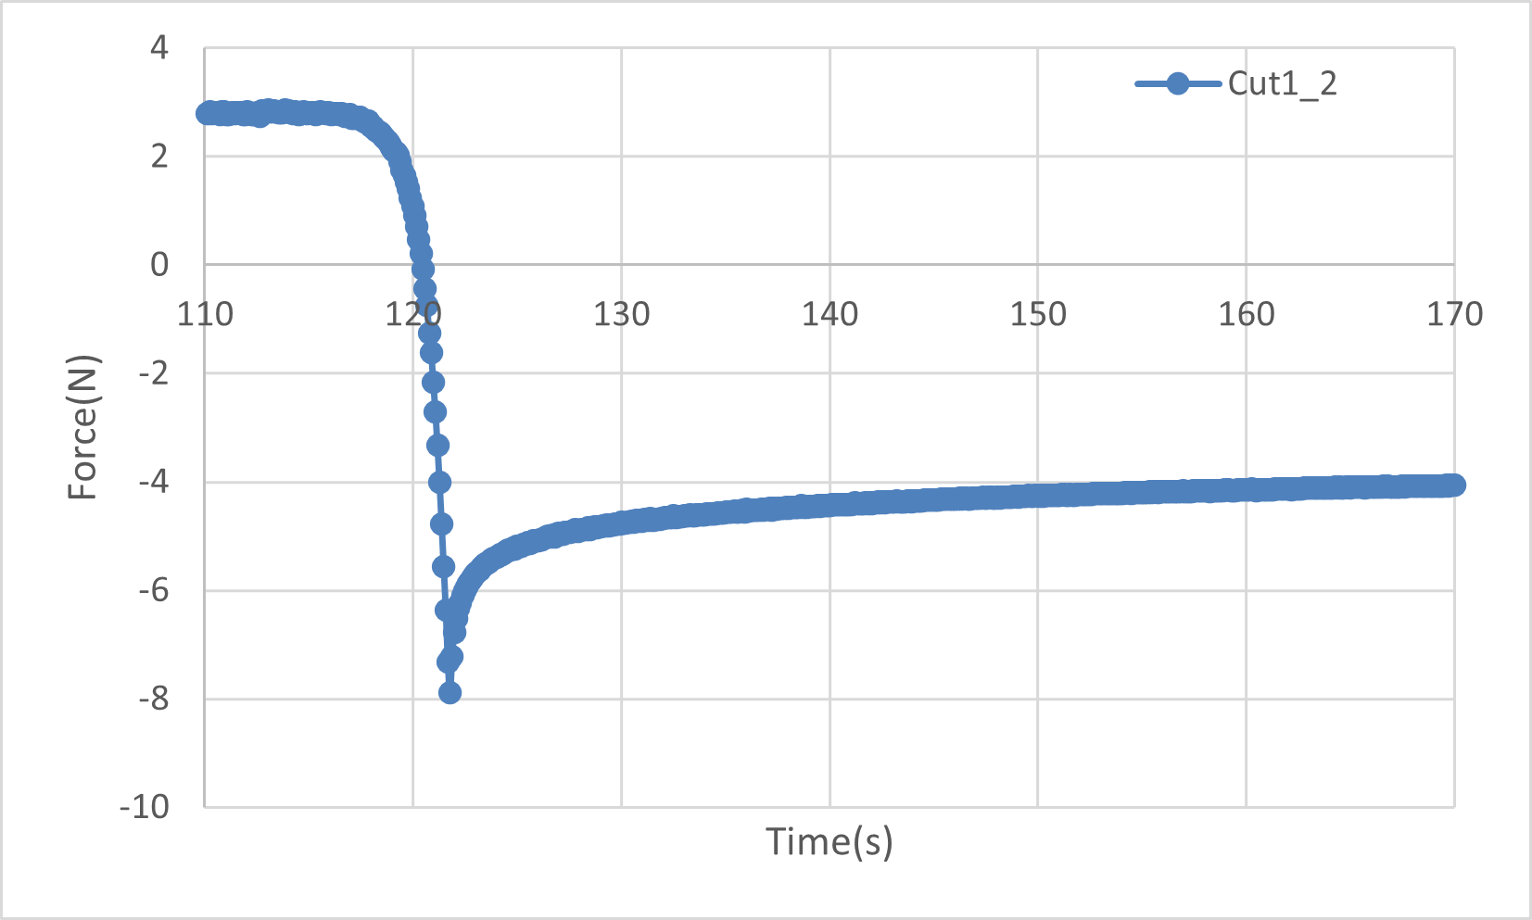
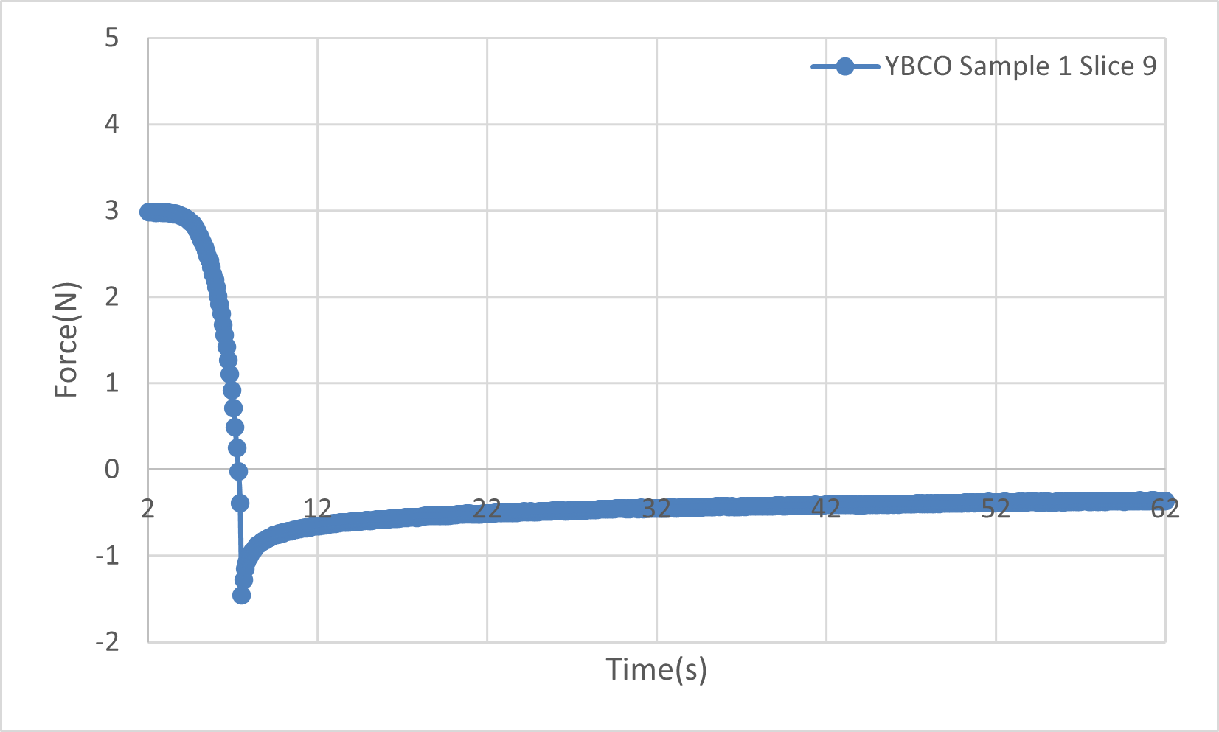
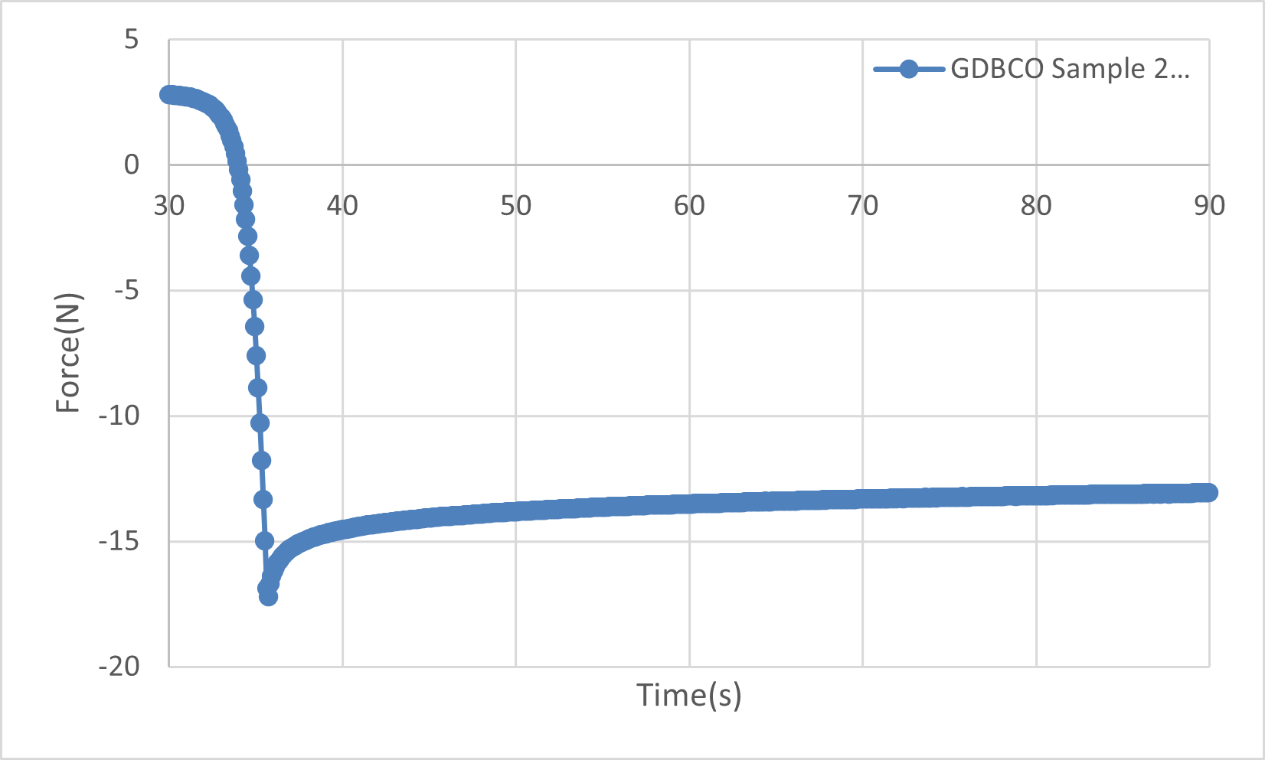
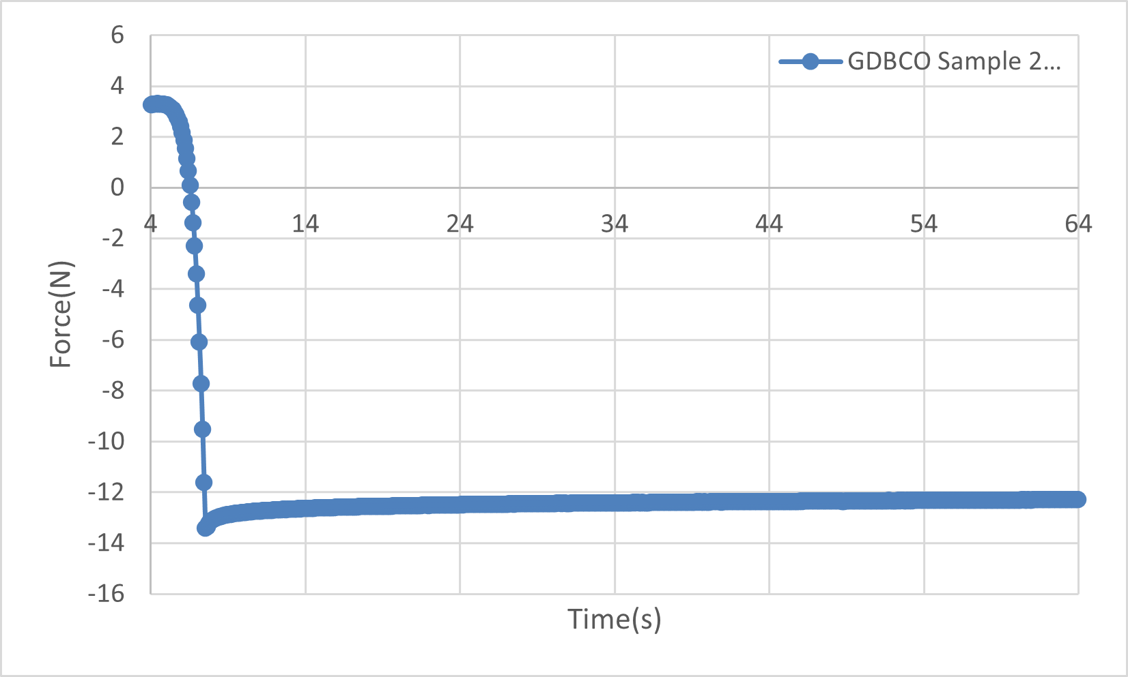
Tinius Olsen work
Overview
Results

Slide 3
MagMapper
Radial plots
Characteristics
Accuracy

Slide 4
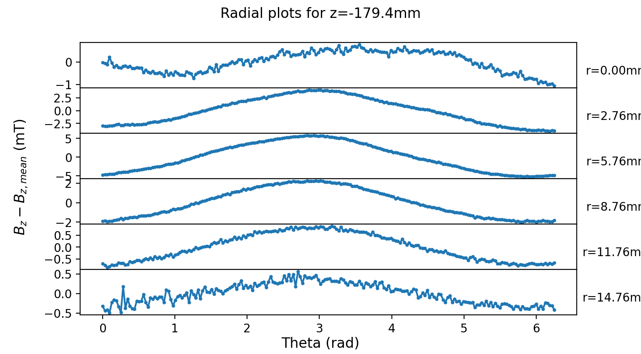
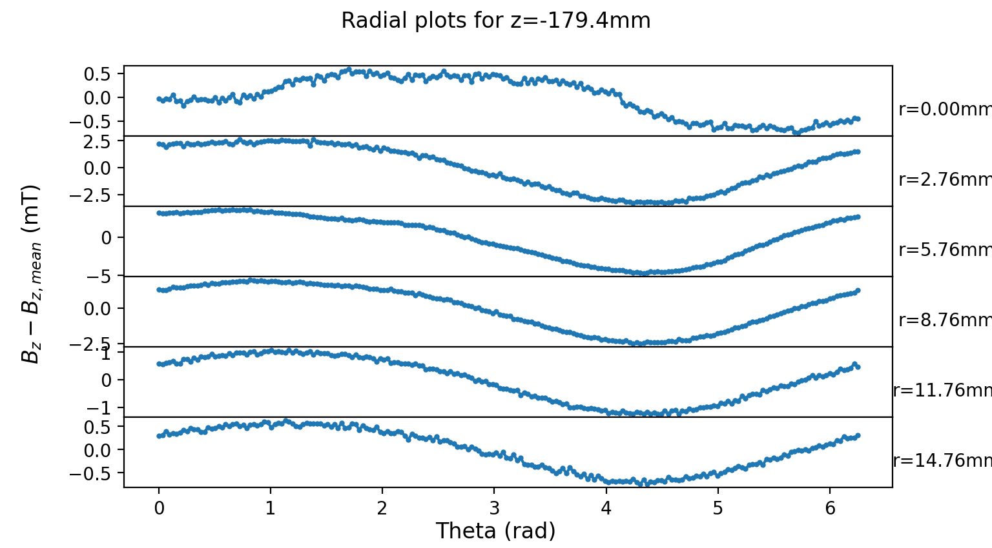
C350_12 with extra centering
C350_5

Slide 5
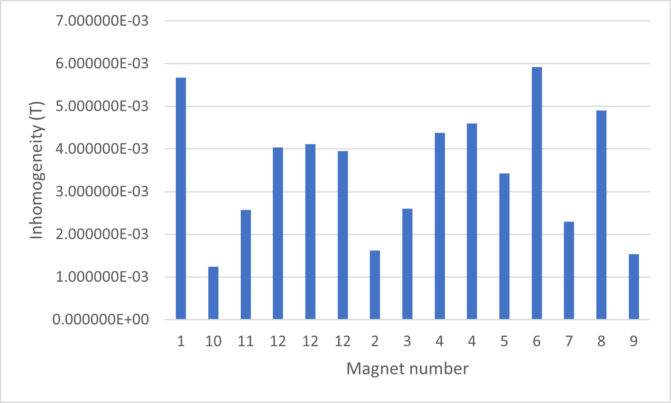
Inhomogeneity

Slide 6
Future work on accuracy
Effects of day vs night measures
Check duplicates agree with standard deviation
Evaluate difference of more centered measurements

Slide 7
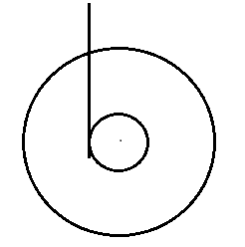


Centering
How measurements were taken
Observed changes
Missing data
Auto-centering with LabVIEW
Evaluation of severity
Exaggerated example of the effect

Slide 8
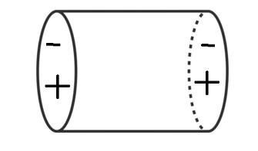
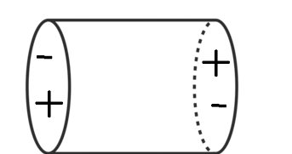
Further characterization
Aligning and comparing centres of magnetism
Aligned, offset motion
Oppositely aligned, twisting motion

Slide 9
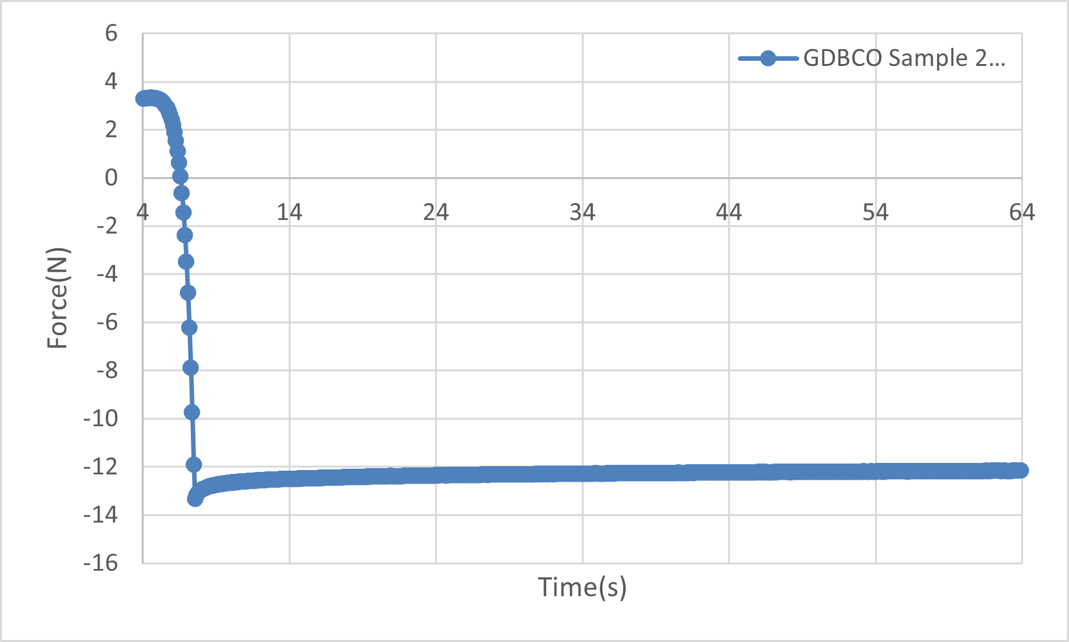
Consistency (optional slide)

Slide 10
Inhomogeneity data
Tims_measurements\C350_1\C350_1_N_rot2(ovn): | 5.670451E-03
Tims_measurements\C350_10\C350_10_N_rot(day): | 1.240204E-03
Tims_measurements\C350_11\C350_11_N_rot(ovn): | 2.572426E-03
Tims_measurements\C350_12\C350_12_N_rot(ovn): | 4.041569E-03
Tims_measurements\C350_12\C350_12_N_rot(ovn)_xtracentred: | 4.112059E-03
Tims_measurements\C350_12\C350_12_N_rot(ovn)_xtracentred_x: | 3.948451E-03
Tims_measurements\C350_2\C350_2_N_rot3: | 1.618059E-03
Tims_measurements\C350_3\C350_3_N_rot1(day): | 2.597059E-03
Tims_measurements\C350_4\C350_4_N_rot1(ovn)(partial): | 4.379857E-03
Tims_measurements\C350_4\C350_4_N_rot2(ovn): | 4.600784E-03
Tims_measurements\C350_5\C350_5_N_rot(day): | 3.432039E-03
Tims_measurements\C350_6\C350_6_N_rot(ovn): | 5.923765E-03
Tims_measurements\C350_7\C350_7_N_rot(day): | 2.300148E-03
Tims_measurements\C350_8\C350_8_N_rot(ovn): | 4.902815E-03
Tims_measurements\C350_9\C350_9_N_rot(ovn): | 1.535115E-03

